Slide 1
Next Generation of Consumer Growth
Clare Savage, Chair, Australian Energy Regulator

Slide 2
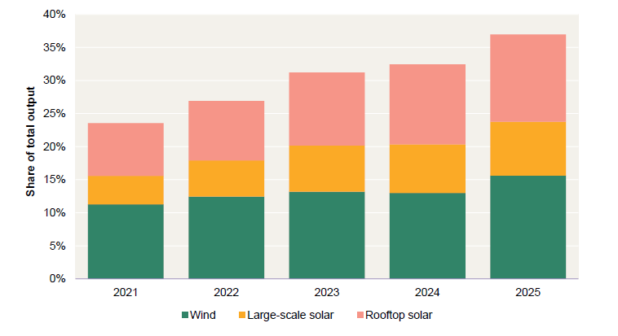
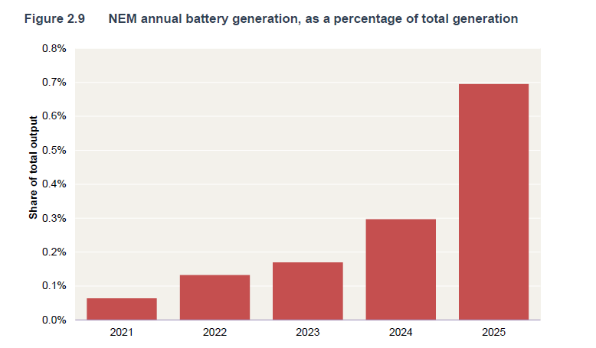
Australia’s generation mix continues to shift towards intermittent renewables and storage
NEM annual wind and solar generation, as a percentage of total generation
NEM annual battery generation, as a percentage of total generation
Source: AER Wholesale electricity market performance report 2026, Figures 2.8 & 2.9

Slide 3
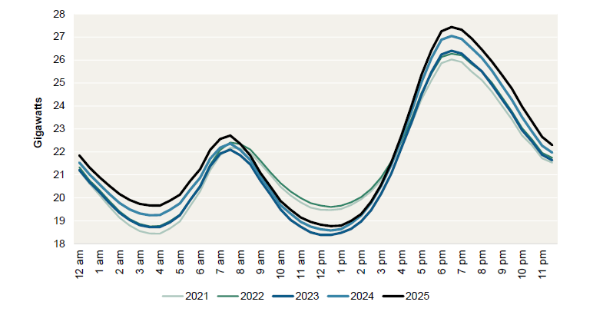
Demand continues to increase at all times of the day, particularly outside the daytime
Average NEM native demand, by time of day
Source: AER Wholesale electricity market performance report 2026, Figure 2.11

Slide 4
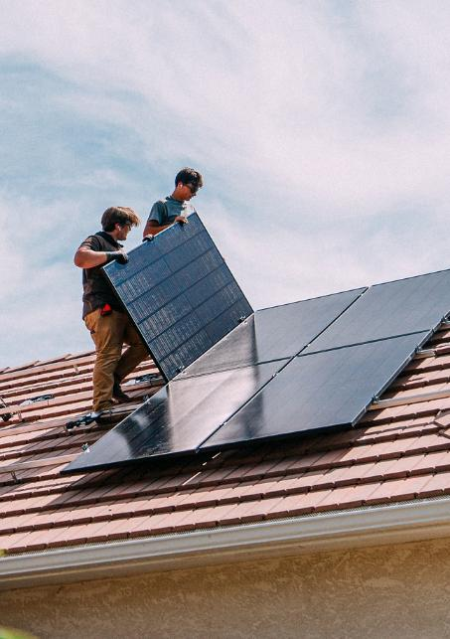
Large customers pose challenges and opportunities for the system
Data centre usage is projected to increase seven fold over the next decade and to grow from 3% to 13% of operational demand
New Government Small-Scale Renewable Energy Scheme to expand from 100kW to 1MW.
Ensure generation, firming, network capacity and system services are available in the right locations at the right times.
1
Build firm capacity
2
Considering locational signals
3
Allocate costs efficiently
4
Improve visibility and coordination

Slide 5

Time of use and two-way tariffs can help manage the impact of EV charging on our electricity networks
The AER has approved two-way tariffs that reward customers when their vehicle-to-grid (V2G) enabled electric vehicles send electricity back to the grid, encouraging wider use of bidirectional charging.
Dynamic tariffs and flexible load tariffs, currently being trialed in New South Wales, provide additional ways for networks to send customers price signals that help support the grid.

Slide 6
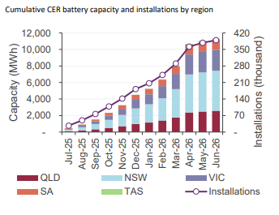
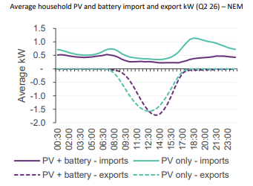
Small customers with access to CER are accelerating and supporting the transition
Australian Government’s Cheaper Home Batteries program has supported more households to install batteries
Households with solar and batteries shift their exports into later in the day and reduce their imports during peaks
Source: AEMO QED report q2 2026, Figure 9
Source: AEMO QED report q2 2026, Figure 10

Slide 7
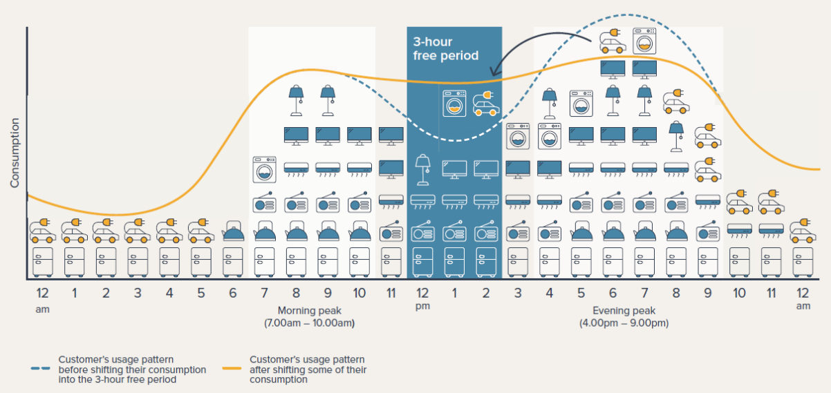
Ensuring those consumers without CER can benefit from the transition, and are protected
The Solar Sharer Offer is an opt-in energy offer that provides eligible households with 3 hours of free electricity in the middle of the day.

